Slide 1


Research Study Design II
DEPH 312 Principles of Scientific Evidence
Talal Alshihayb ^{BDS, DScD}
Diplomate, American Board of Dental Public Health
Assistant Professor
Department of Preventive Dental Science, College of Dentistry, King Saud bin Abdulaziz University for Health Sciences
Department of Health Policy and Health Services Research, Henry M. Goldman School of Dental Medicine, Boston University
December 7, 2023
shihaybt@ksau-hs.edu.sa

Slide 2
Recap
Study tasks
Descriptive
Predictive
Causal
Descriptive epidemiology
Measures of disease occurrence

Slide 3
 | Descriptive | Predictive | Causal
Identifies | The extent of the disease | Who are at higher risk to have the disease | The reason for having the disease
Reports | Measure of disease occurrence | Model performance | Measure of association
Stage | First | Second | Third
Asks | How spread is the problem | Who is at higher risk to have the disease now? To have the disease in the future? to have disease progress? | Would I have gotten lung cancer had I not smoked?
Helps in | Setting priorities (deciding which disease to pay attention to) | Setting priorities (deciding who to target with an intervention on a certain disease) | Figure out what to intervene on to prevent disease or its progress

Slide 4

LECTURE LEARNING OUTCOMES OF EACH OF THE DIDACTIC SESSIONS
REFERENCE:
Chapter 2 in Westreich, Daniel. Epidemiology by Design. Oxford University Press. Kindle Edition
P. 56-65 of chapter 4 in Epidemiology an Introduction by Kenneth Rothman
Section 1.5 of Chapter 1 in Oral Epidemiology A Textbook on Oral Health Conditions, Research Topics and Methods
LECTURE LEARNING OUTCOMES:
Differentiate between the different measures of association.

Slide 5
Measures of disease association
Compare measures of disease occurrence between groups
Difference
Risk difference (incidence proportion difference)
Incidence rate difference
Incidence time difference
Null value 0
0 means no difference
Ratio
Risk ratio
Incidence rate ratio
Incidence time ratio
Hazard ratio
Incidence odds ratio
Prevalence ratio
Prevalence odds ratio
Null value 1
1 means no difference

Slide 6
Measures of association using prevalence disease occurrence measures

Slide 7

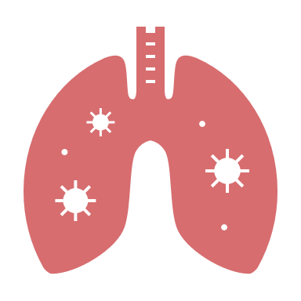
Prevalence difference and ratio Comparing who has disease right now between two exposure groups
Independent variable
Exposure groups (males/females)
Dependent variable
Outcome (has lung cancer/no lung cancer)
Time

Slide 8



Prevalence difference and ratio Comparing who has disease right now between two exposure groups
 | Diseased | Non-diseased | Total
Exposed | A | B | A+B
Unexposed | C | D | C+D
Total | A+C | B+D | A+B+C+D
Prevalence among exposed=$\frac{A}{A+B}$
Measure of disease occurrence
Prevalence among unexposed=$\frac{C}{C+D}$
Measure of disease occurrence
Prevalence difference=prevalence among exposed-prevalence among unexposed= $\frac{A}{A+B} − \frac{C}{C+D}$
0 means no difference
> 0 exposed higher
< 0 unexposed higher
Prevalence ratio=$\frac{\text{prevalence} \text{among} \text{exposed}}{\text{prevalence} \text{among} \text{unexposed}}$= $\frac{\frac{A}{A+B}}{\frac{C}{C+D}}$
1 means no difference
> 1 exposed higher
< 1 unexposed higher
Measures of association comparing exposed to unexposed

Slide 9
Prevalence difference and ratio Example of comparing current smokers among male and female KSAUHS students in 2022
 | Smokers | Non-smokers | Total
Males | 100 | 600 | 700
Females | 20 | 280 | 300
Total | 120 | 880 | 1,000
Prevalence among males=$\frac{100}{100+600}=\frac{100}{700}=0.14=14\%$
Prevalence among females=$\frac{20}{20+280}=\frac{20}{300}=0.07=7\%$
Prevalence difference=prevalence among males-prevalence among females= $0.14−0.07=0.07$
Prevalence ratio=$\frac{\text{prevalence} \text{among} males}{\text{prevalence} \text{among} females}$= $\frac{0.14}{0.07}=2$
Measures of association comparing males to females

Slide 10
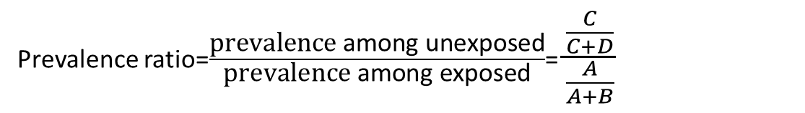
Prevalence difference and ratio Comparing who has disease right now between two exposure groups
 | Diseased | Non-diseased | Total
Exposed | A | B | A+B
Unexposed | C | D | C+D
Total | A+C | B+D | A+B+C+D
Prevalence among exposed=$\frac{A}{A+B}$
Measure of disease occurrence
Prevalence among unexposed=$\frac{C}{C+D}$
Measure of disease occurrence
Prevalence difference=prevalence among unexposed-prevalence among exposed= $\frac{C}{C+D} − \frac{A}{A+B}$
0 means no difference
> 0 exposed higher
< 0 unexposed higher
Prevalence ratio=$\frac{\text{prevalence} \text{among} \text{un}\text{exposed}}{\text{prevalence} \text{among} \text{exposed}}$= $\frac{\frac{C}{C+D}}{\frac{A}{A+B}}$
1 means no difference
> 1 exposed higher
< 1 unexposed higher
Measures of association comparing unexposed to exposed

Slide 11
Prevalence difference and ratio Example of comparing current smokers among male and female KSAUHS students in 2022
 | Smokers | Non-smokers | Total
Males | 100 | 600 | 700
Females | 20 | 280 | 300
Total | 120 | 880 | 1,000
Prevalence among males=$\frac{100}{100+600}=\frac{100}{700}=0.14=14\%$
Prevalence among females=$\frac{20}{20+280}=\frac{20}{300}=0.07=7\%$
Prevalence difference=prevalence among females-prevalence among males= $0.07−0.14=−0.07$
Prevalence ratio=$\frac{\text{prevalence} \text{among} females}{\text{prevalence} \text{among} males}$= $\frac{0.07}{0.14}=0.5$
Measures of association comparing females to males

Slide 12
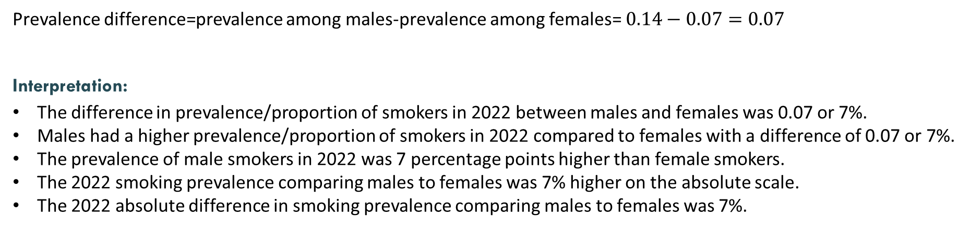
Prevalence difference interpretation Example of comparing current smokers among male and female KSAUHS students in 2022
 | Smokers | Non-smokers | Total
Males | 100 | 600 | 700
Females | 20 | 280 | 300
Total | 120 | 880 | 1,000
Measure of association comparing males to females
Prevalence difference=prevalence among males-prevalence among females= $0.14−0.07=0.07$
Interpretation:
The difference in prevalence/proportion of smokers in 2022 between males and females was 0.07 or 7%.
Males had a higher prevalence/proportion of smokers in 2022 compared to females with a difference of 0.07 or 7%.
The prevalence of male smokers in 2022 was 7 percentage points higher than female smokers.
The 2022 smoking prevalence comparing males to females was 7% higher on the absolute scale.
The 2022 absolute difference in smoking prevalence comparing males to females was 7%.

Slide 13
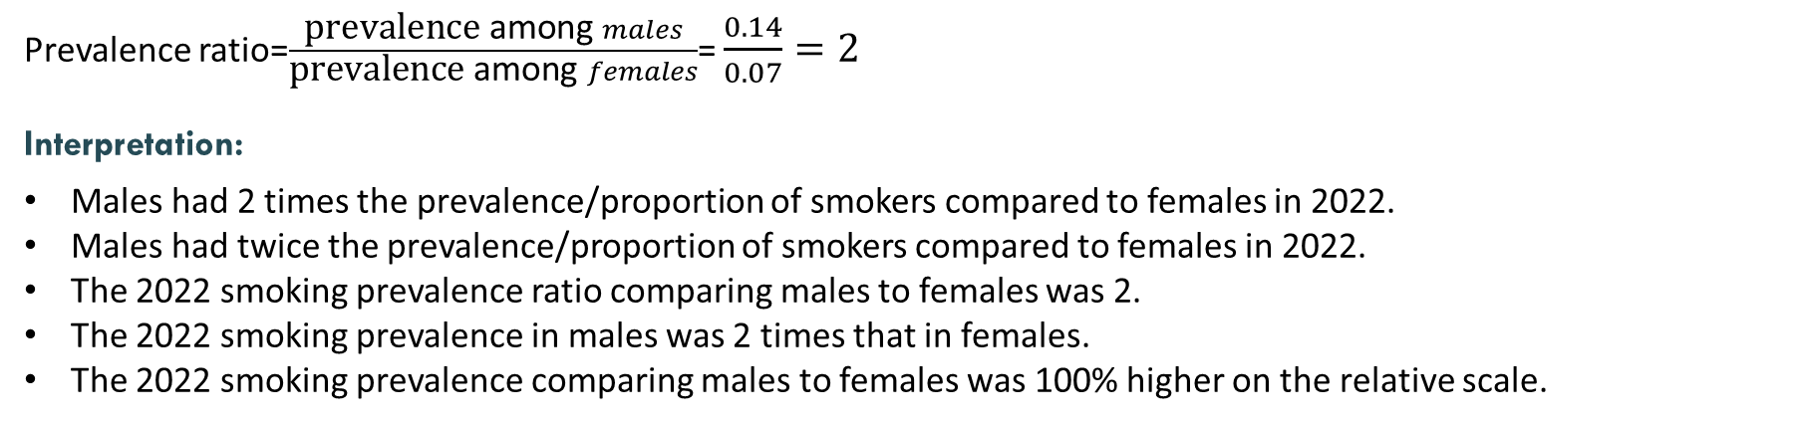
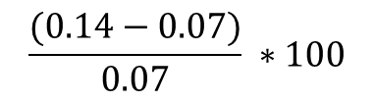
Prevalence ratio interpretation Example of comparing current smokers among male and female KSAUHS students in 2022
 | Smokers | Non-smokers | Total
Males | 100 | 600 | 700
Females | 20 | 280 | 300
Total | 120 | 880 | 1,000
Measure of association comparing males to females
Prevalence ratio=$\frac{\text{prevalence} \text{among} males}{\text{prevalence} \text{among} females}$= $\frac{0.14}{0.07}=2$
Interpretation:
Males had 2 times the prevalence/proportion of smokers compared to females in 2022.
Males had twice the prevalence/proportion of smokers compared to females in 2022.
The 2022 smoking prevalence ratio comparing males to females was 2.
The 2022 smoking prevalence in males was 2 times that in females.
The 2022 smoking prevalence comparing males to females was 100% higher on the relative scale.
$$\frac{(0.14−0.07)}{0.07} ∗100$$

Slide 14
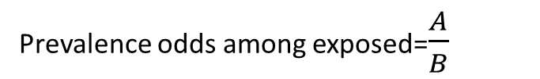
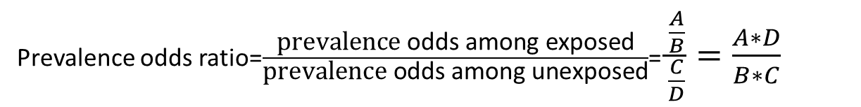
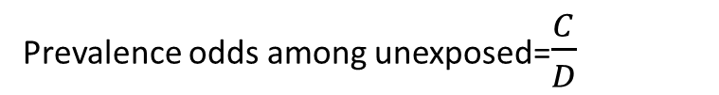
Prevalence odds ratio
 | Diseased | Non-diseased | Total
Exposed | A | B | A+B
Unexposed | C | D | C+D
Total | A+C | B+D | A+B+C+D
Prevalence odds among exposed=$\frac{A}{B}$
Measure of disease occurrence
Prevalence odds among unexposed=$\frac{C}{D}$
Measure of disease occurrence
Prevalence odds ratio=$\frac{\text{prevalence} \text{odds} \text{among} \text{exposed}}{\text{prevalence} \text{odds} \text{among} \text{unexposed}}$= $\frac{\frac{A}{B}}{\frac{C}{D}}=\frac{A∗D}{B∗C}$
1 means no difference
> 1 exposed higher
< 1 unexposed higher
Measure of association comparing exposed to unexposed

Slide 15
Prevalence odds ratio Example of comparing current smokers among male and female KSAUHS students in 2022
 | Smokers | Non-smokers | Total
Males | 100 | 600 | 700
Females | 20 | 280 | 300
Total | 120 | 880 | 1,000
Prevalence odds among males=$\frac{100}{600}=\frac{100}{600}=0.17$
Prevalence odds among females=$\frac{20}{280}=\frac{20}{280}=0.07$
Prevalence odds ratio=$\frac{\text{prevalence} \text{odds} \text{among} males}{\text{prevalence} \text{odds} \text{among} females}$= $\frac{0.17}{0.07}=2.43$
Measure of association comparing males to females

Slide 16
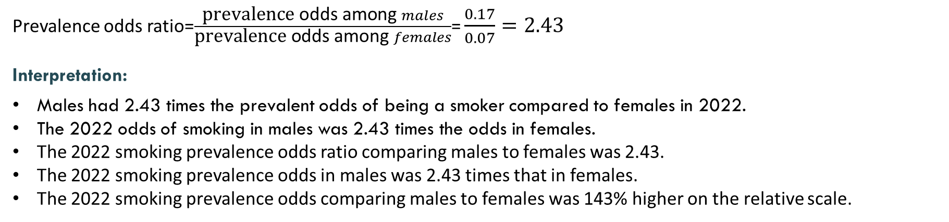
Prevalence odds ratio interpretation Example of comparing current smokers among male and female KSAUHS students in 2022
 | Smokers | Non-smokers | Total
Males | 100 | 600 | 700
Females | 20 | 280 | 300
Total | 120 | 880 | 1,000
Measure of association comparing males to females
Prevalence odds ratio=$\frac{\text{prevalence} \text{odds} \text{among} males}{\text{prevalence} \text{odds} \text{among} females}$= $\frac{0.17}{0.07}=2.43$
Interpretation:
Males had 2.43 times the prevalent odds of being a smoker compared to females in 2022.
The 2022 odds of smoking in males was 2.43 times the odds in females.
The 2022 smoking prevalence odds ratio comparing males to females was 2.43.
The 2022 smoking prevalence odds in males was 2.43 times that in females.
The 2022 smoking prevalence odds comparing males to females was 143% higher on the relative scale.

Slide 17
Prevalence odds ratio and prevalence ratio Example of comparing current smokers among male and female KSAUHS students
 | Smokers | Non-smokers | Total
Males | 100 | 600 | 700
Females | 20 | 280 | 300
Total | 120 | 880 | 1,000
Prevalence odds
Prevalence
Prevalence odds among males=$\frac{100}{600}=\frac{100}{600}=0.17$
Prevalence among males=$\frac{100}{100+600}=\frac{100}{700}=0.14$
Prevalence odds among females=$\frac{20}{280}=\frac{20}{280}=0.07$
Prevalence among females=$\frac{20}{20+280}=\frac{20}{300}=0.07$
Prevalence odds ratio=$\frac{\text{prevalence} \text{odds} \text{among} males}{\text{prevalence} \text{odds} \text{among} females}$= $\frac{0.17}{0.07}=2.43$
Prevalence ratio=$\frac{\text{prevalence} \text{among} males}{\text{prevalence} \text{among} females}$= $\frac{0.14}{0.07}=2$
Why are they not the same?

Slide 18
 | P | Odds
Approximated | 0.05 | 0.05/0.95=0.053
 | 0.06 | 0.06/0.94=0.064
 | 0.10 | 0.10/0.90=0.111
Overestimated | 0.11 | 0.11/0.89=0.124
Overestimated | 0.12 | 0.12/0.88=0.136
 | 0.13 | 0.13/0.87=0.149
 | 0.14 | 0.14/0.86=0.163
 | 0.15 | 0.15/0.85=0.176
 | 0.16 | 0.16/0.84=0.190
 | 0.17 | 0.17/0.83=0.205
 | 0.20 | 0.20/0.80=0.250

Slide 19
Why calculate prevalence odds ratio and not prevalence ratio?
Use non-smokers to approximate total population
 | Smokers | Non-smokers | Total
Males | 100 | 600 | 700
Females | 20 | 280 | 300
Total | 120 | 880 | 1,000
So how can we calculate prevalence in this case!!
If the total is not known, prevalence can’t be calculated

Slide 20
Measures of association using incidence disease occurrence measures

Slide 21


Incidence difference and ratio Comparing who develops new disease after sometime between two exposure groups
Independent variable
Exposure groups (males/females)
Only those without lung cancer at baseline (at risk for developing lung cancer)
Dependent variable
Outcome (develops lung cancer/doesn’t)
Time 0
Baseline
Time

Slide 22

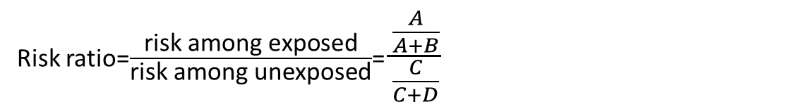

Incidence difference and ratio Comparing who develops new disease after sometime between two exposure groups
 | Diseased | Non-diseased | Total
Exposed | A | B | A+B
Unexposed | C | D | C+D
Total | A+C | B+D | A+B+C+D
Risk among exposed=$\frac{A}{A+B}$
Measure of disease occurrence
Risk among unexposed=$\frac{C}{C+D}$
Measure of disease occurrence
Risk difference=risk among exposed-risk among unexposed= $\frac{A}{A+B} − \frac{C}{C+D}$
0 means no difference
> 0 exposed higher
< 0 unexposed higher
Risk ratio=$\frac{\text{risk} \text{among} \text{exposed}}{\text{risk} \text{among} \text{unexposed}}$= $\frac{\frac{A}{A+B}}{\frac{C}{C+D}}$
1 means no difference
> 1 exposed higher
< 1 unexposed higher
Measures of association comparing exposed to unexposed

Slide 23

First let’s go back to our prevalence example Example of comparing current smokers among male and female KSAUHS students in 2022
 | Smokers | Non-smokers | Total
Males | 100 | 600 | 700
Females | 20 | 280 | 300
Total | 120 | 880 | 1,000
Already smokers so they are not at risk for starting smoking because they have already done so
Only included and followed up to see who starts smoking

Slide 24


Incidence difference and ratio Example of comparing new smokers after 1 year (initiators) among male and female KSAUHS students
 | Initiate smoking | Doesn’t initiate smoking | Total
Males | 150 | 450 | 600
Females | 50 | 230 | 280
Total | 200 | 680 | 880
Risk among males=$\frac{150}{150+450}=\frac{150}{600}=0.25=25\%$
Risk among females=$\frac{50}{50+230}=\frac{50}{280}=0.18=18\%$
Risk difference=risk among males-risk among females= $0.25 −0.18=0.07$
Risk ratio=$\frac{\text{risk} \text{among} males}{\text{risk} \text{among} females}$= $\frac{0.25}{0.18}=1.39$
Measures of association comparing males to females

Slide 25
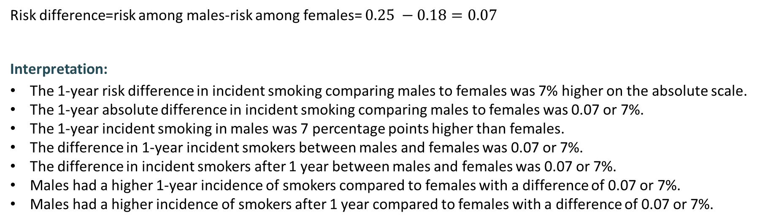
Incidence difference interpretation Example of comparing new smokers after 1 year (initiators) among male and female KSAUHS students
 | Initiate smoking | Doesn’t initiate smoking | Total
Males | 150 | 450 | 600
Females | 50 | 230 | 280
Total | 200 | 680 | 880
Measure of association comparing males to females
Risk difference=risk among males-risk among females= $0.25 −0.18=0.07$
Interpretation:
The 1-year risk difference in incident smoking comparing males to females was 7% higher on the absolute scale.
The 1-year absolute difference in incident smoking comparing males to females was 0.07 or 7%.
The 1-year incident smoking in males was 7 percentage points higher than females.
The difference in 1-year incident smokers between males and females was 0.07 or 7%.
The difference in incident smokers after 1 year between males and females was 0.07 or 7%.
Males had a higher 1-year incidence of smokers compared to females with a difference of 0.07 or 7%.
Males had a higher incidence of smokers after 1 year compared to females with a difference of 0.07 or 7%.

Slide 26
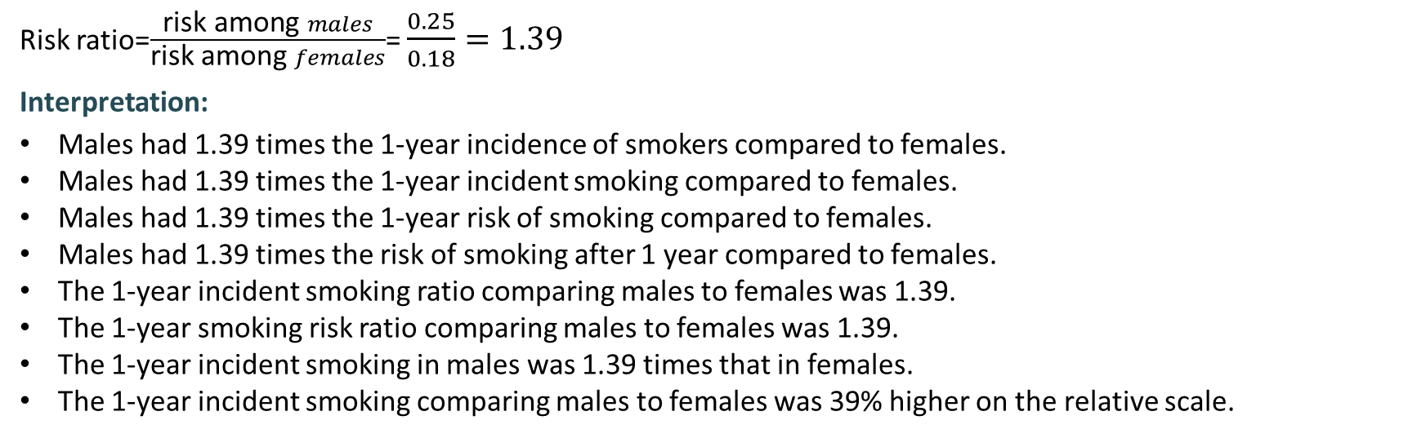
Incidence ratio interpretation Example of comparing new smokers after 1 year (initiators) among male and female KSAUHS students
 | Initiate smoking | Doesn’t initiate smoking | Total
Males | 150 | 450 | 600
Females | 50 | 230 | 280
Total | 200 | 680 | 880
Measure of association comparing males to females
Risk ratio=$\frac{\text{risk} \text{among} males}{\text{risk} \text{among} females}$= $\frac{0.25}{0.18}=1.39$
Interpretation:
Males had 1.39 times the 1-year incidence of smokers compared to females.
Males had 1.39 times the 1-year incident smoking compared to females.
Males had 1.39 times the 1-year risk of smoking compared to females.
Males had 1.39 times the risk of smoking after 1 year compared to females.
The 1-year incident smoking ratio comparing males to females was 1.39.
The 1-year smoking risk ratio comparing males to females was 1.39.
The 1-year incident smoking in males was 1.39 times that in females.
The 1-year incident smoking comparing males to females was 39% higher on the relative scale.

Slide 27

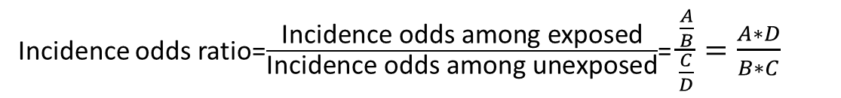

Incidence odds ratio
 | Diseased | Non-diseased | Total
Exposed | A | B | A+B
Unexposed | C | D | C+D
Total | A+C | B+D | A+B+C+D
Incidence odds among exposed=$\frac{A}{1−A}=\frac{A}{B}$
Measure of disease occurrence
Incidence odds among unexposed=$\frac{C}{1−C}=\frac{C}{D}$
Measure of disease occurrence
Incidence odds ratio=$\frac{\text{Incidence} \text{odds} \text{among} \text{exposed}}{\text{Incidence} \text{odds} \text{among} \text{unexposed}}$= $\frac{\frac{A}{B}}{\frac{C}{D}}=\frac{A∗D}{B∗C}$
Measures of association comparing exposed to unexposed
1 means no difference
> 1 exposed higher
< 1 unexposed higher
Difficult to interpret so only makes sense to interpret it as an approximation to risk ratio
Approximates risk ratio if risk < 0.1

Slide 28
Incidence odds ratio Example of comparing new smokers after 1 year (initiators) among male and female KSAUHS students
 | Initiate smoking | Doesn’t initiate smoking | Total
Males | 150 | 450 | 600
Females | 50 | 230 | 280
Total | 200 | 680 | 880
Incidence odds among males=$\frac{150}{450}=0.33$
Incidence odds among females=$\frac{50}{230}=0.22$
Incidence odds ratio=$\frac{\text{incidence} \text{odds} \text{among} males}{\text{incidence} \text{odds} \text{among} females}$= $\frac{0.33}{0.22}=1.50$
Measures of association comparing males to females

Slide 29
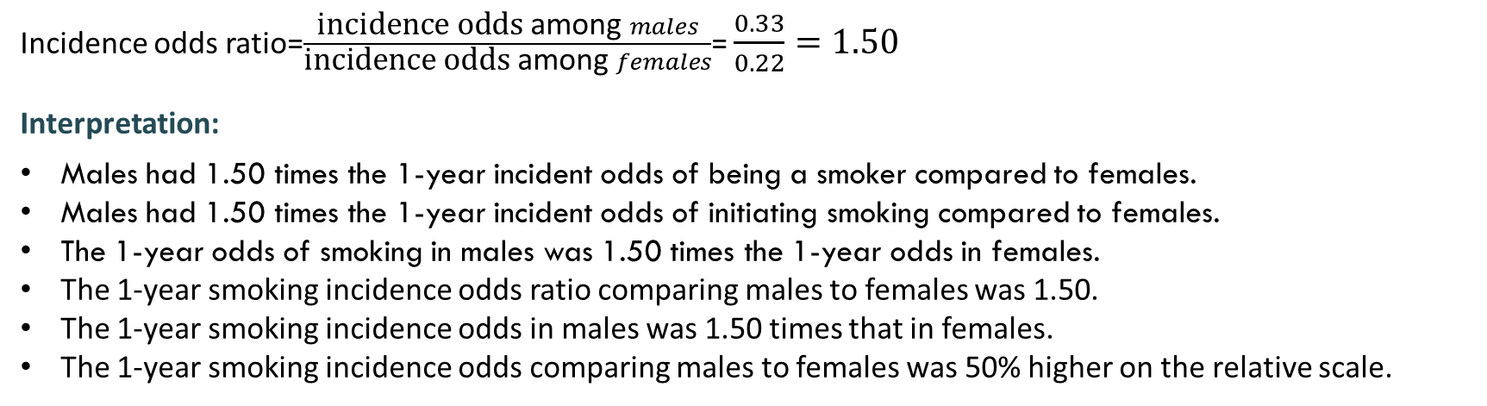
Incidence odds ratio interpretation Example of comparing new smokers after 1 year (initiators) among male and female KSAUHS students
 | Initiate smoking | Doesn’t initiate smoking | Total
Males | 150 | 450 | 600
Females | 50 | 230 | 280
Total | 200 | 680 | 880
Measure of association comparing males to females
Incidence odds ratio=$\frac{\text{incidence} \text{odds} \text{among} males}{\text{incidence} \text{odds} \text{among} females}$= $\frac{0.33}{0.22}=1.50$
Interpretation:
Males had 1.50 times the 1-year incident odds of being a smoker compared to females.
Males had 1.50 times the 1-year incident odds of initiating smoking compared to females.
The 1-year odds of smoking in males was 1.50 times the 1-year odds in females.
The 1-year smoking incidence odds ratio comparing males to females was 1.50.
The 1-year smoking incidence odds in males was 1.50 times that in females.
The 1-year smoking incidence odds comparing males to females was 50% higher on the relative scale.

Slide 30


Incidence odds ratio and incident odds Example of comparing new smokers after 1 year (initiators) among male and female KSAUHS students
 | Initiate smoking | Doesn’t initiate smoking | Total
Males | 150 | 450 | 600
Females | 50 | 230 | 280
Total | 200 | 680 | 880
Incidence odds
Incidence (risk)
Incidence odds among males=$\frac{150}{450}=0.33$
Risk among males=$\frac{150}{150+450}=\frac{150}{600}=0.25$
Incidence odds among females=$\frac{50}{230}=0.22$
Risk among females=$\frac{50}{50+230}=\frac{50}{280}=0.18$
Incidence odds ratio=$\frac{\text{incidence} \text{odds} \text{among} males}{\text{incidence} \text{odds} \text{among} females}$= $\frac{0.33}{0.22}=1.50$
Risk ratio=$\frac{\text{risk} \text{among} males}{\text{risk} \text{among} females}$= $\frac{0.25}{0.18}=1.39$
Why are they not the same?

Slide 31
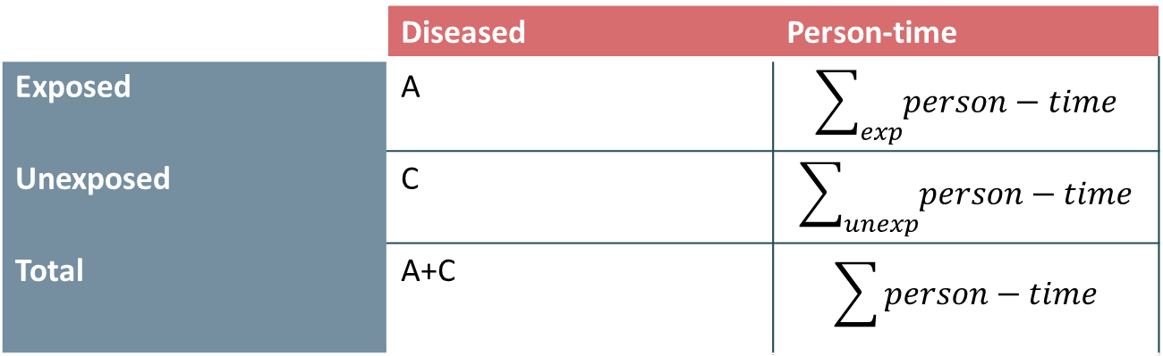
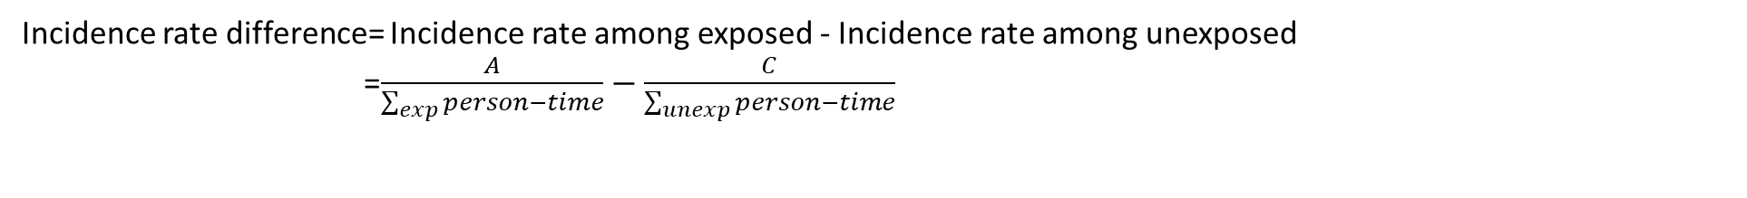
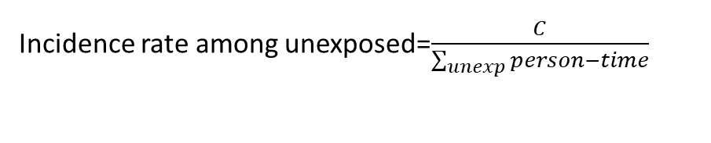
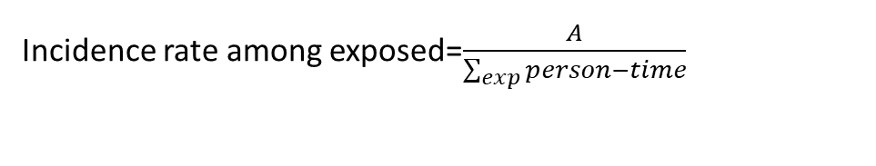
Incidence rate difference and ratio
 | Diseased | Person-time
Exposed | A | $$\sum_{exp}{person−time}$$
Unexposed | C | $$\sum_{unexp}{person−time}$$
Total | A+C | $$\sum{person−time}$$
Incidence rate among exposed=$\frac{A}{\sum_{exp}{person−time}}$
Measure of disease occurrence
Incidence rate among unexposed=$\frac{C}{\sum_{unexp}{person−time}}$
Measure of disease occurrence
0 means no difference
> 0 exposed higher
< 0 unexposed higher
Incidence rate difference= Incidence rate among exposed - Incidence rate among unexposed
=$\frac{A}{\sum_{exp}{person−time}}−\frac{C}{\sum_{unexp}{person−time}}$
1 means no difference
> 1 exposed higher
< 1 unexposed higher
Incidence rate ratio=$\frac{\text{Incidence} \text{rate} \text{among} \text{exposed}}{\text{Incidence} \text{rate} \text{among} \text{unexposed}}$= $\frac{\frac{A}{\sum_{exp}{person−time}}}{\frac{C}{\sum_{unexp}{person−time}}}$
Measures of association comparing exposed to unexposed

Slide 32
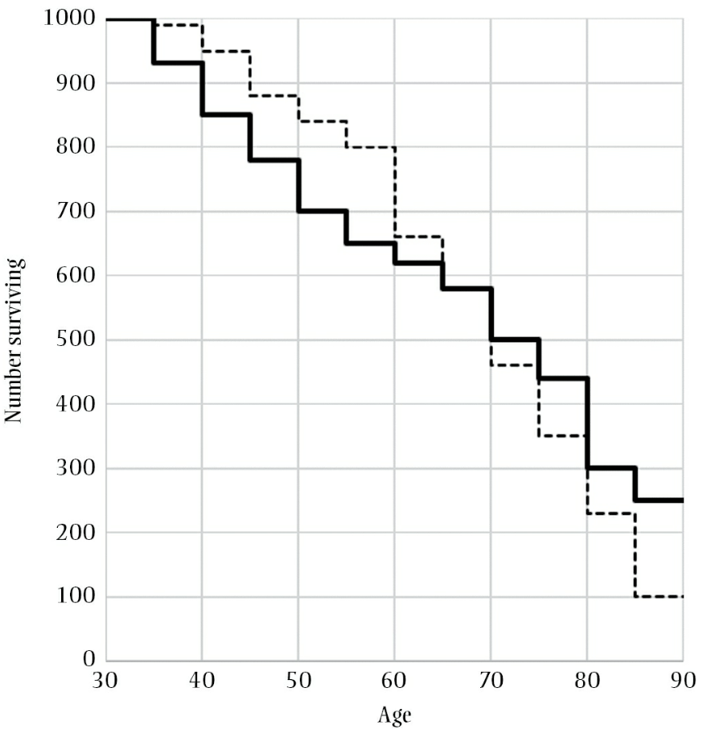
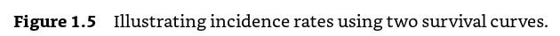
Incidence proportion at 65 for solid line =420/1,000=0.42
Incidence proportion at 65 for dotted line =420/1,000=0.42
Person-time: time contributed by each individual while at risk for developing the outcome
Examples:
One person is followed for 1 year while at risk for death contributes 1 person-year
One person is followed for 10 years while at risk for death contributes 10 person-years
Ten persons each followed for 1 year while at risk for death contribute 10 person-years
Westreich D. Epidemiology by design: a causal approach to the health sciences. Oxford University Press; 2019 Oct 16.

Slide 33
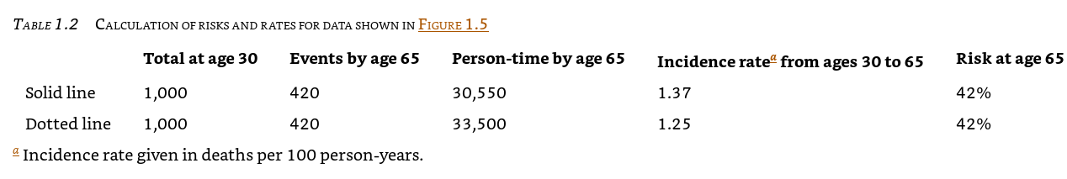
Westreich D. Epidemiology by design: a causal approach to the health sciences. Oxford University Press; 2019 Oct 16.

Slide 34
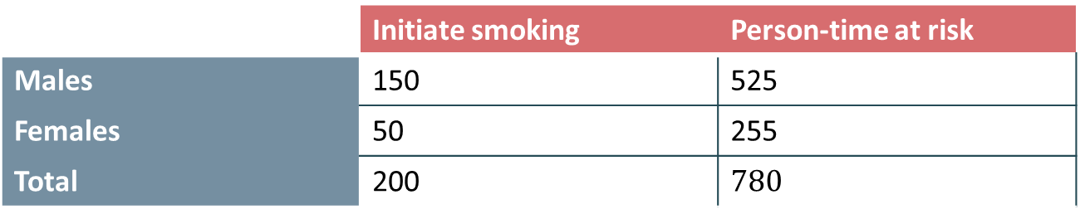
Incidence rate difference and ratio Example of comparing new smokers after 1 year (initiators) among male and female KSAUHS students
 | Initiate smoking | Person-time at risk
Males | 150 | 525
Females | 50 | 255
Total | 200 | $$780$$
Incidence rate among males=$\frac{150}{525}=0.29$ per person-years
Incidence rate among females=$\frac{50}{255}=0.20$ per person-years
Incidence rate difference= Incidence rate among males - Incidence rate among females=0.29-0.20=0.09 per person-years
Incidence rate ratio=$\frac{\text{Incidence} \text{rate} \text{among} males}{\text{Incidence} \text{rate} \text{among} females}$= $\frac{0.29}{0.20}=1.45$
Measures of association comparing males to females

Slide 35
Incidence rate difference interpretation Example of comparing new smokers after 1 year (initiators) among male and female KSAUHS students
 | Initiate smoking | Person-time at risk
Males | 150 | 525
Females | 50 | 255
Total | 200 | $$780$$
Measure of association comparing males to females
Incidence rate difference= Incidence rate among males - Incidence rate among females=0.29-0.20=0.09 per person-years
Interpretation:
The difference in incident smoking rate comparing males to females was 0.09 per person-years.
Males had a higher incidence rate of smokers compared to females with a difference of 0.09 per person-years.

Slide 36
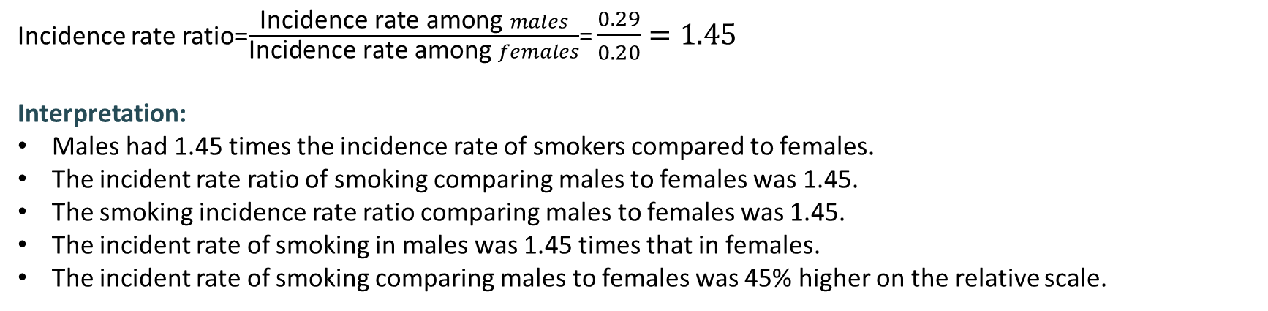
Incidence rate ratio interpretation Example of comparing new smokers after 1 year (initiators) among male and female KSAUHS students
 | Initiate smoking | Person-time at risk
Males | 150 | 525
Females | 50 | 255
Total | 200 | $$780$$
Measure of association comparing males to females
Incidence rate ratio=$\frac{\text{Incidence} \text{rate} \text{among} males}{\text{Incidence} \text{rate} \text{among} females}$= $\frac{0.29}{0.20}=1.45$
Interpretation:
Males had 1.45 times the incidence rate of smokers compared to females.
The incident rate ratio of smoking comparing males to females was 1.45.
The smoking incidence rate ratio comparing males to females was 1.45.
The incident rate of smoking in males was 1.45 times that in females.
The incident rate of smoking comparing males to females was 45% higher on the relative scale.

Slide 37

Relation between incidence (risk), incidence rate, and incidence odds
Risk
Incidence rate where events occur at the end of follow-up interval
Rate
Incidence rate where events can happen anywhere in the follow-up interval
Odds
Incidence rate where events occur at the start of follow-up interval
Incidence odds < Incidence rate < Incidence (Risk)
Odds
0 person-year
Rate
0.5 person-year
Risk
1 person-year
Time 0
1 year
Follow up

Slide 38
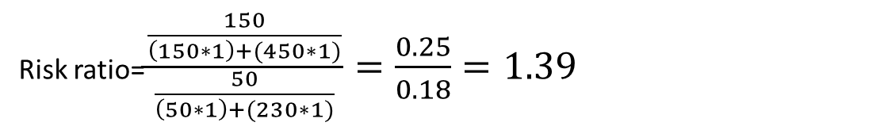

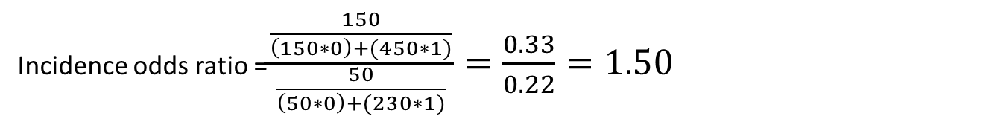
Relation between incidence (risk), incidence rate, and incidence odds
 | Initiate smoking | Doesn’t initiate smoking | Total
Males | 150 | 450 | 600
Females | 50 | 230 | 280
Total | 200 | 680 | 880
Risk ratio=$\frac{\frac{150}{\left(150∗1\right)+(450∗1)}}{\frac{50}{\left(50∗1\right)+(230∗1)}}=\frac{0.25}{0.18}=1.39$
Incidence rate ratio= $\frac{\frac{150}{\left(150∗0.5\right)+(450∗1)}}{\frac{50}{\left(50∗0.5\right)+(230∗1)}}=\frac{0.29}{0.20} =1.45$
Incidence odds ratio =$\frac{\frac{150}{\left(150∗0\right)+(450∗1)}}{\frac{50}{\left(50∗0\right)+(230∗1)}}=\frac{0.33}{0.22}=1.50$

Slide 39
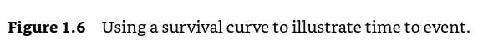
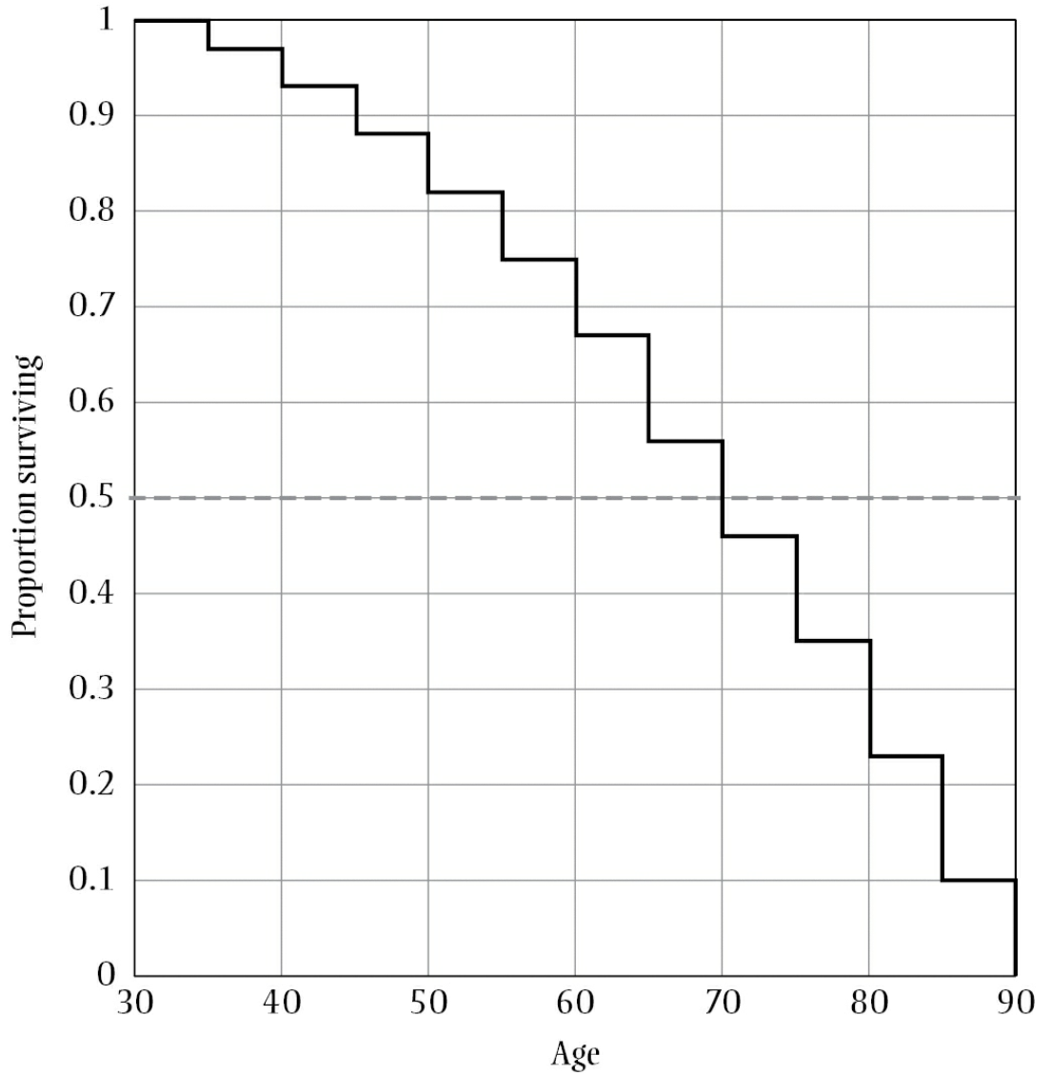
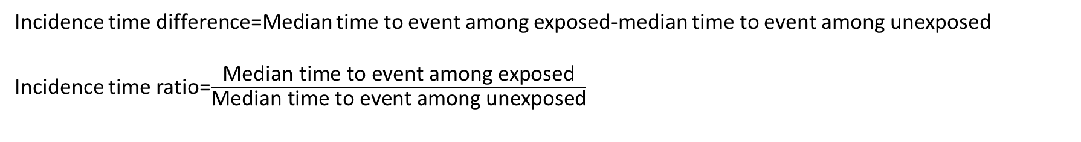
Incidence time difference=Median time to event among exposed-median time to event among unexposed
Incidence time ratio=$\frac{\text{Median} \text{time} \text{to} \text{event} \text{among} \text{exposed}}{\text{M}\text{edian} \text{time} \text{to} \text{event} \text{among} \text{unexposed}}$
Westreich D. Epidemiology by design: a causal approach to the health sciences. Oxford University Press; 2019 Oct 16.

Slide 40
Measures of disease association
Hazard ratio
Instantaneous rate (rate conditional on having survived and not experienced the event yet)
Difficult to interpret

Slide 41
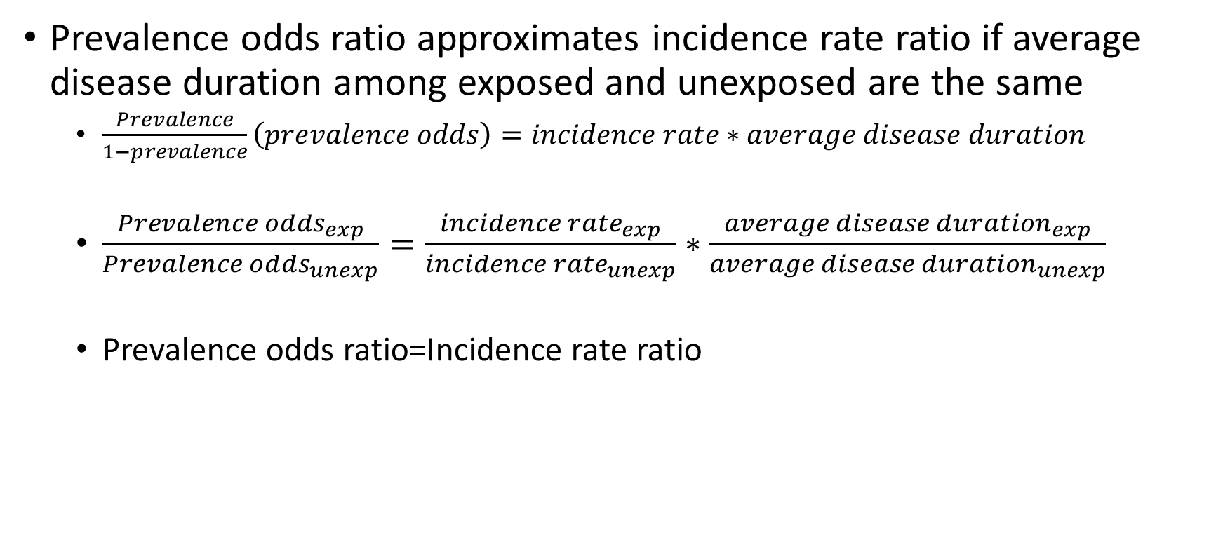
Relation between prevalence odds ratio and incidence rate ratio
Prevalence odds ratio approximates incidence rate ratio if average disease duration among exposed and unexposed are the same
$\frac{Prevalence}{1−prevalence}\left(prevalence odds\right)=incidence rate∗average disease duration$
$\frac{{Prevalence odds}_{exp}}{{Prevalence odds}_{unexp}}=\frac{{incidence rate}_{exp}}{{incidence rate}_{unexp}}∗\frac{{average disease duration}_{exp}}{{average disease duration}_{unexp}}$
Prevalence odds ratio=Incidence rate ratio

Slide 42
Summary
 | Measure | Range
Difference | Risk difference | -1 to 1
 | Incidence rate difference | -infinity to infinity
 | Incidence time difference | -infinity to infinity
Ratio | Risk ratio | 0 to infinity
 | Incidence rate ratio | 0 to infinity
 | Incidence time ratio | 0 to infinity
 | Hazard ratio | 0 to infinity
 | Incidence odds ratio | 0 to infinity
 | Prevalence ratio | 0 to infinity
 | Prevalence odds ratio | 0 to infinity

Slide 43
Any Questions?
shihaybt@ksau-hs.edu.sa

